Slide 1

ANTI-THEFT SYSTEM IN AUTOMOBILE USING IOT
NATIONAL INSTITUTE OF TECHNOLOGY NAGALAND
DEPARTMENT OF COMPUTER SCIENCE AND ENGINEERING
Chumukedima, Dimapur – 797103, Nagaland
Presented by:
Aosenba Longchar(2015105114)
Milong Walling(2015105119)
Under the guidance of:
Mr. Sibesh Lodh

Slide 2
CONTENTS
INTRODUCTION
APPLICATIONS
3. ANTI-THEFT SYSTEM
- Components
- Proposed Model
3. FLOW DIAGRAM
4. ALGORITHM FOR ANTI-THEFT
-Algorithm for Motion Detection
IMPLEMENTATION
-Sample Output when the Vehicle is Stationary.
-Sample Output when the Vehicle is in motion.
-Alert message received at the users end.
FUTURE WORKS
REFERENCES

Slide 3
INTRODUCTION
What is Internet of Things?
The internet of things (IoT)is the network of physical objects devices, vehicles and other items embedded with electronics, software,
Sensors and network connectivity that enables these objects to collect and exchange data.
How Internet of Things works?
The IoT works in such a way that the information is collected from the device or hardware using sensors or modules and which is then transferred through the gateway or network .User can then access the information from the cloud storage using a mobile app.

Slide 4
Why Internet of Things?
It makes things easier.
Communication between multiple devices.
Remote access.

Slide 5
APPLICATIONS
Some of the Applications of IoT are:
Smart homes.
Smart city.
Healthcare.
Anti-theft system.

Slide 6
ANTI-THEFT SYSTEM
Anti-theft system for vehicles is to establish a connection between vehicle and the user. The established connection enables the vehicle to notify the user in situation of theft and the user can tract the vehicle at real time.
The main functions of the anti-theft system are:
Design a mechanism to detect theft and notify user of the theft.
To implement system to provide vehicle tracking in real time.

Slide 7
1. Arduino board. 2. adxl335(3AXIS accelerometer) 3. mtk3339(GPs tracker) 4. sim800l(3g module)
Components

Slide 8
Arduino Board
Hardware and software company open-source.
Microcontrollers and microcontroller kits for building digital devices and interactive objects
Senses and control objects in the physical and digital world.
Connection of different modules.

Slide 9
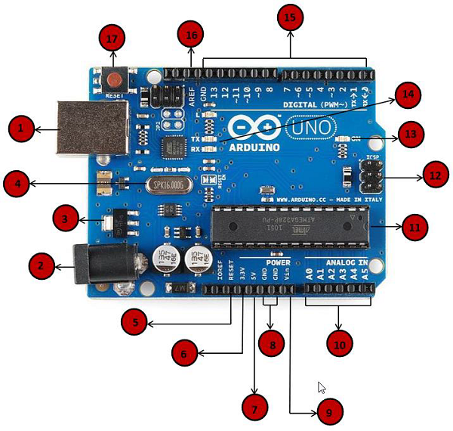
Arduino pin outs
Source:https://cdn.sparkfun.com/r/600-600/assets/b/f/e/9/c/513824face395f6d3d000000.png

Slide 10
ADXL335(3-Axis Accelerometer)
Main components:
The ADXL335 performs the following functions
Range ±3 g in the x, y and z axis.
Output as analog voltages that are proportional to the acceleration.
Polysilicon surface-micro machined sensor and signal conditioning circuitry.

Slide 11
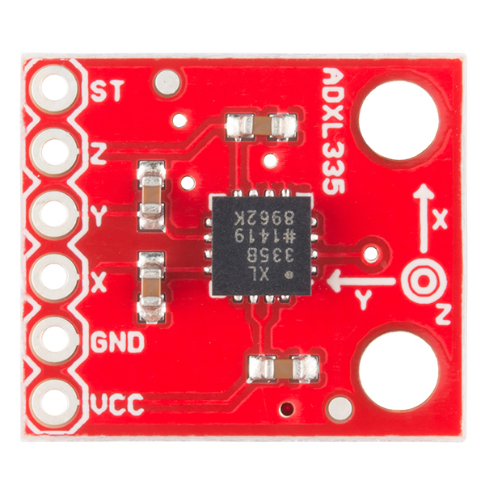
ADXL335 Pin outs
SOURCE: https://cdn.sparkfun.com//assets/parts/2/7/6/8/09269-02.jpg

Slide 12
MTK3339(GPS tracker)
Built around the MTK3339 chipset
A no-nonsense, high-quality GPS module that can track up to 22 satellites on 66 channels,
Power usage is incredibly low, only 20 mA during navigation
Antenna functionality and the built-in data-logging capability.

Slide 13
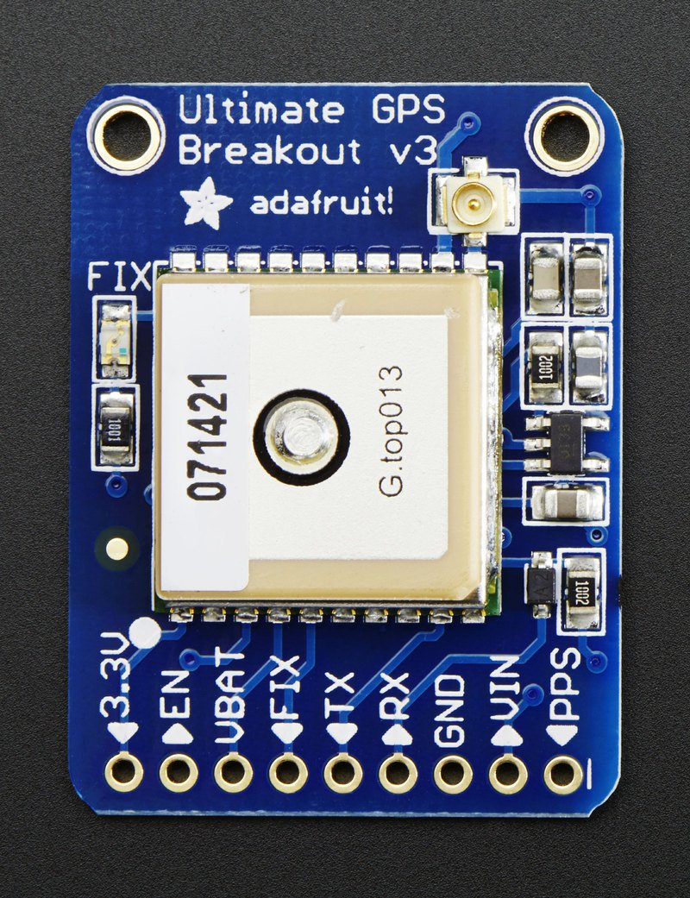
MTK3339 pin outs
Source: https://www.robotshop.com/media/catalog/product/cache/image/625x625/9df78eab33525d08d6e5fb8d27136e95/a/d/adafruit-66-channel-mtk3339-gps-breakout-2.jpg

Slide 14
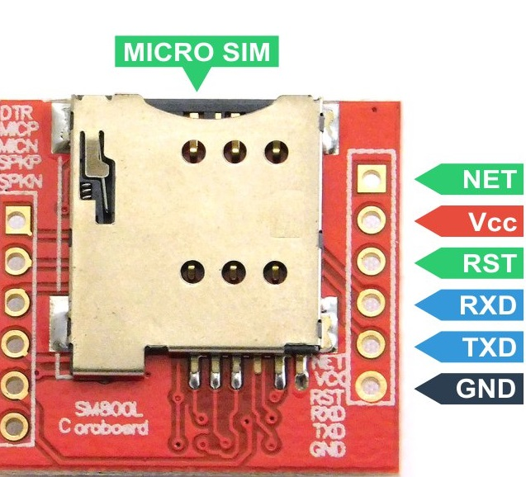
SIM800L Pin outs
Source:
https://nettigo.eu/system/images/1935/original.jpg?1479816092

Slide 15
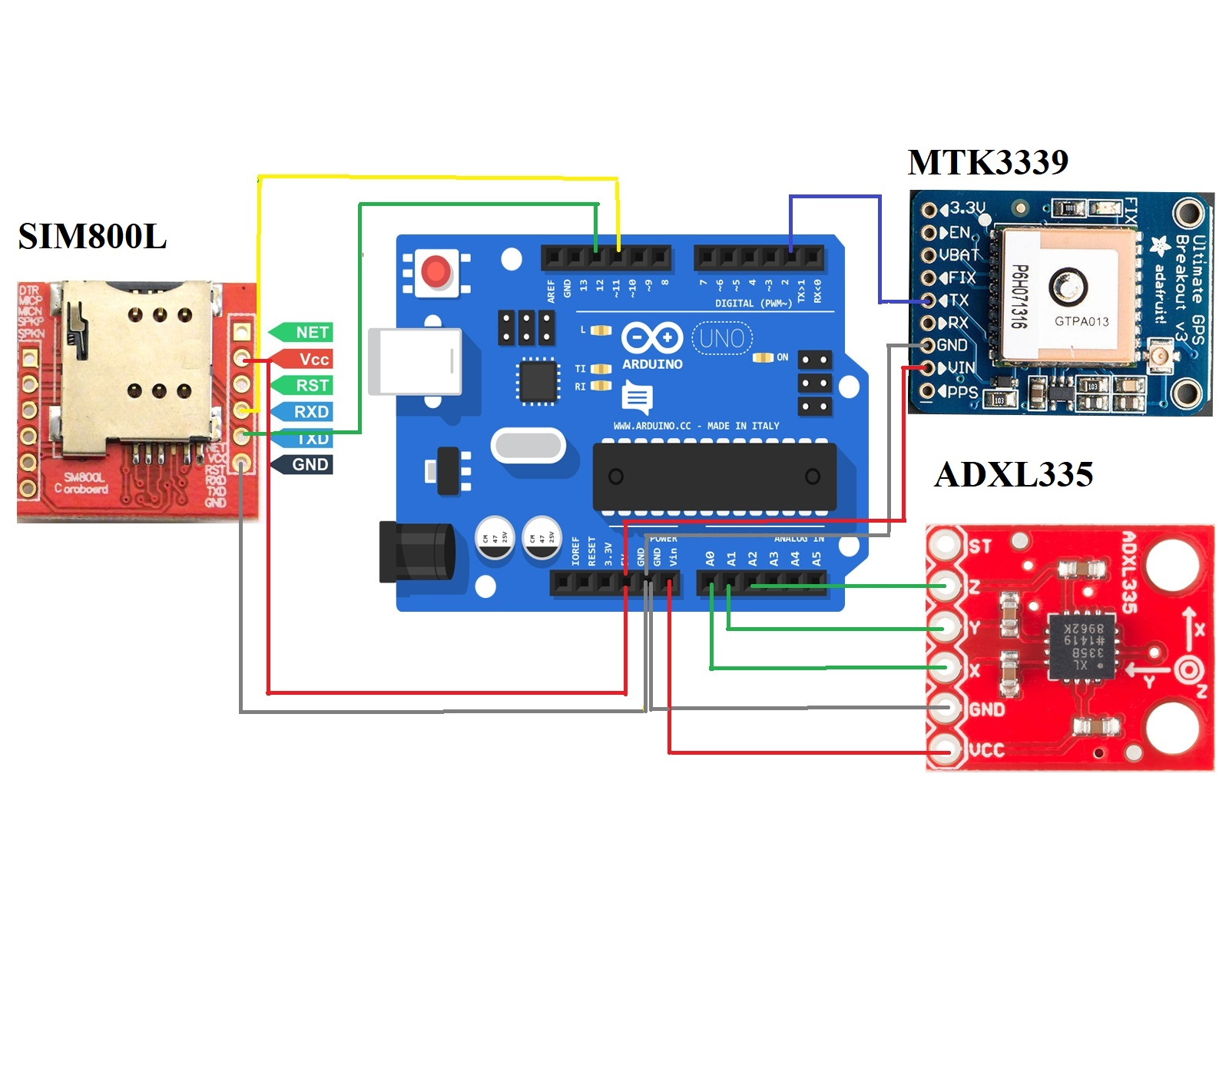
Proposed Model

Slide 16
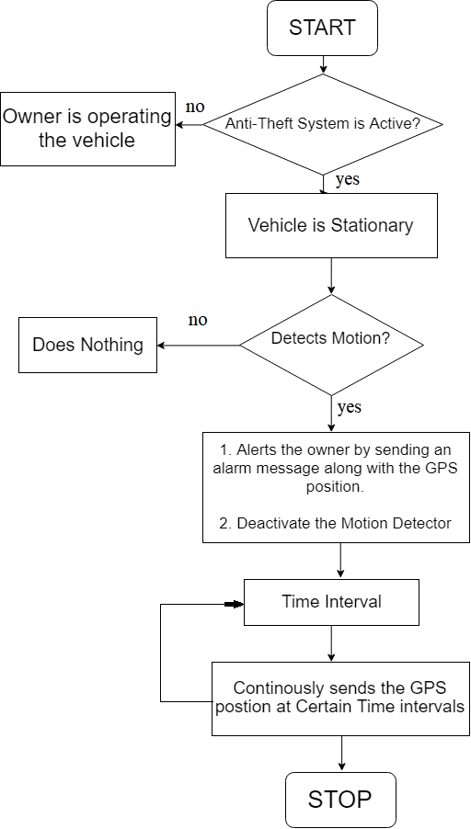
FLOW DIAGRAM
yes
no
yes

Slide 17
ALGORITHM FOR ANTITHEFT SYSTEM
The System can be in any of the two modes
Active mode-The antitheft system is active to detect any kind of intrusion.
Passive mode-The antitheft system is passive and will remain idle.
The system can be manually activated and deactivated by the owner using password authentication.

Slide 18
Algorithm for Motion Detection
Procedure for Motion Detection:
for i = 1 to 10
sumX = sumX + X;
sumY = sumY + Y;
sumZ = sumZ + Z;
end for
avgX = sumX / 10;
avgY = sumY / 10;
avgZ = sumZ / 10;
while (final motion not detected)
if (avgX – currX > 0.14 || avgY – currY > 0.14 || avgZ – currZ > 0.14)
one instance of motion detected;
end if
if (total no. of motion detected out of last 10 instances > 4)
send alert message to the owner;
final motion detected;
end if
end while

Slide 19
IMPLEMENTATION
Arduino IDE 1.8.7
- The open-source Arduino Software (IDE) is used to write code and upload it to the board.
- It runs on Windows, Mac OS X, and Linux. The environment is written in Java and based on Processing and other open-source software. - This software can be used with any Arduino board.

Slide 20
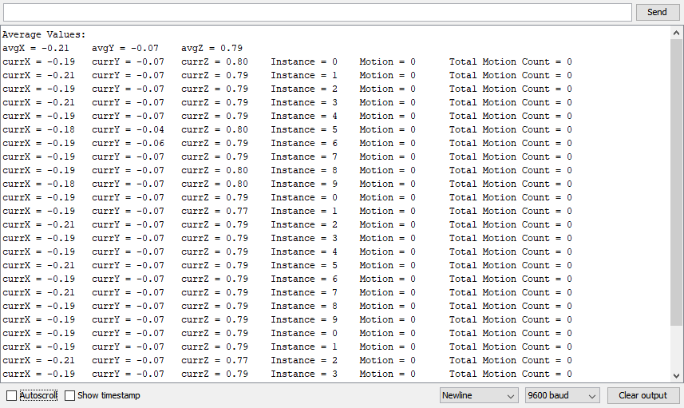
Sample Output when the Vehicle is Stationary and no motion is detected
Fig. Sample output 1.

Slide 21
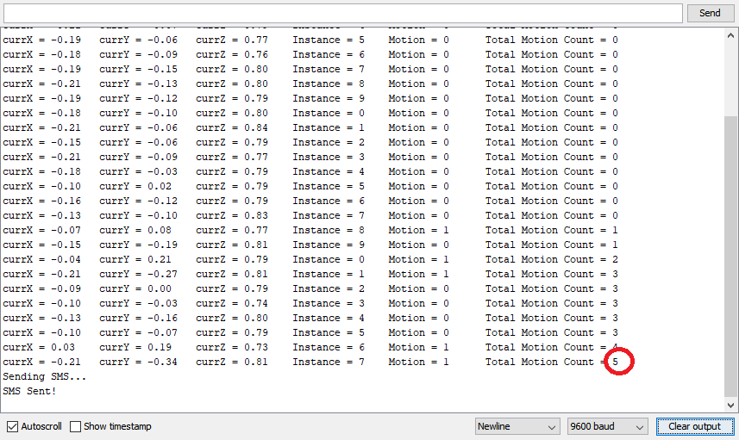
Sample Output when the Vehicle is stationary and motion is detected
Fig. Sample output 2.

Slide 22
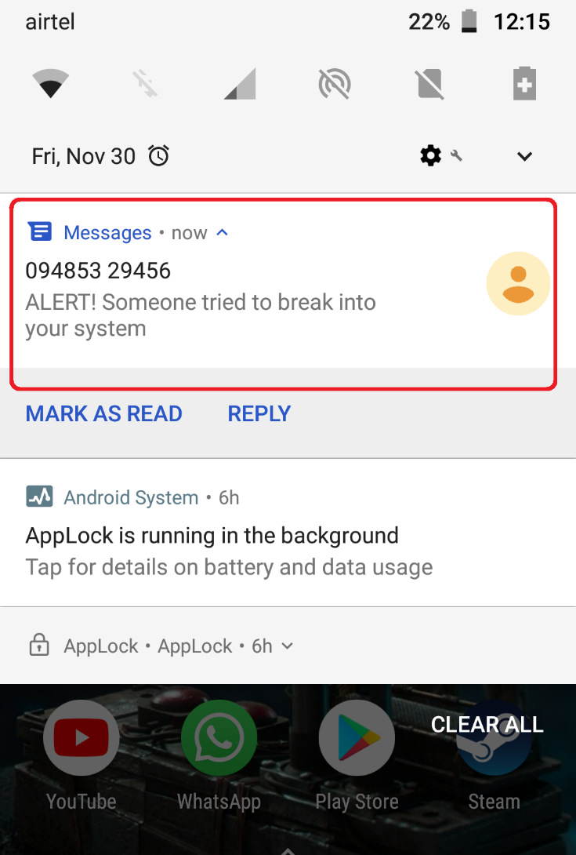
Alert message received at the users end
Fig. Alert Message

Slide 23
FUTURE WORKS
Develop an Android App which can be used by the user for interaction with the System using proper authentication.
Integrating a GPS tracker into the System to transmit the location of the Vehicle at real time.

Slide 24
REFERENCES
1. Hemant Kuruva, Girish Shiva Prasanna Raja S “IoT based anti-theft system for
automobiles”, December 12, 2016.
2. “Digital Accelerometer”- One Technology way, Norwood, MA, USA,2009.
3. H. V. Dadwani, R. B. Buktar, “Vehicle tracking and anti-theft system using IoT”
Volume 4 ,issue 10,october 2017.
4. Arduino pin, “www.theengineeringprojects.com”.
5. ADXl335, “www.instructables.com”.
6. MTK3339, “www.learnadafruit.com”.
7. SIM800l, “www.geeker.co.nz”.
8. ADXL335 and Arduino connection,” http://www.geeetech.com”.
9. SIM800l and Arduino Connection ,” androidmafia.ru”.

Slide 25
THANK YOU

